Slide 1
Leaving no one behind: safe, accessible and inclusive mobility
Katie Bulanowski
Project Manager
European Passengers’ Federation
Date

Slide 2
Main Objectives
About EPF
Represent passengers’ views at European level
Advocate for strong passenger rights
Shape a better (multi-modal) travel experience
Tackle transport poverty
Put end-users at the centre when new mobility services are developed
Leaving no one behind: safe, accessible and inclusive mobility

Slide 3
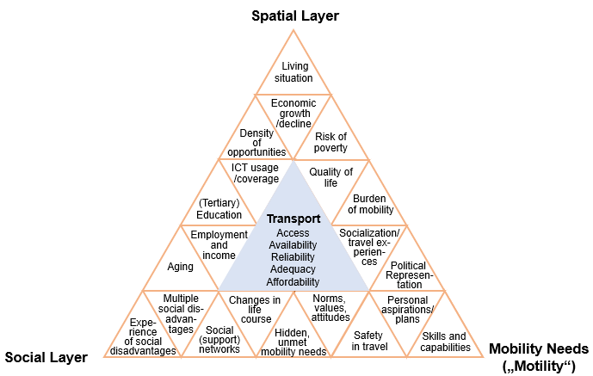
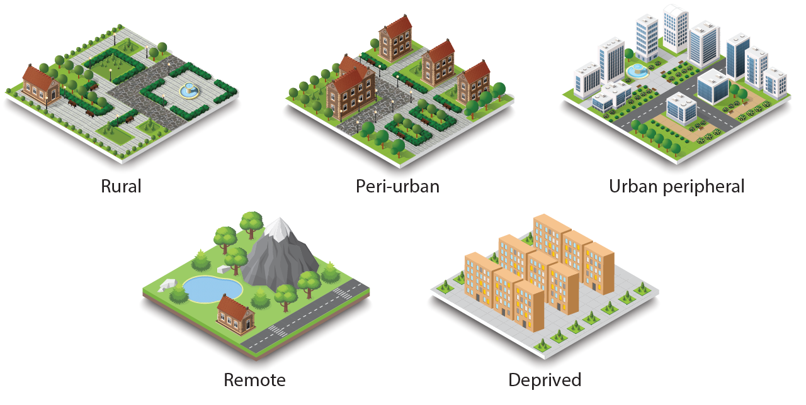
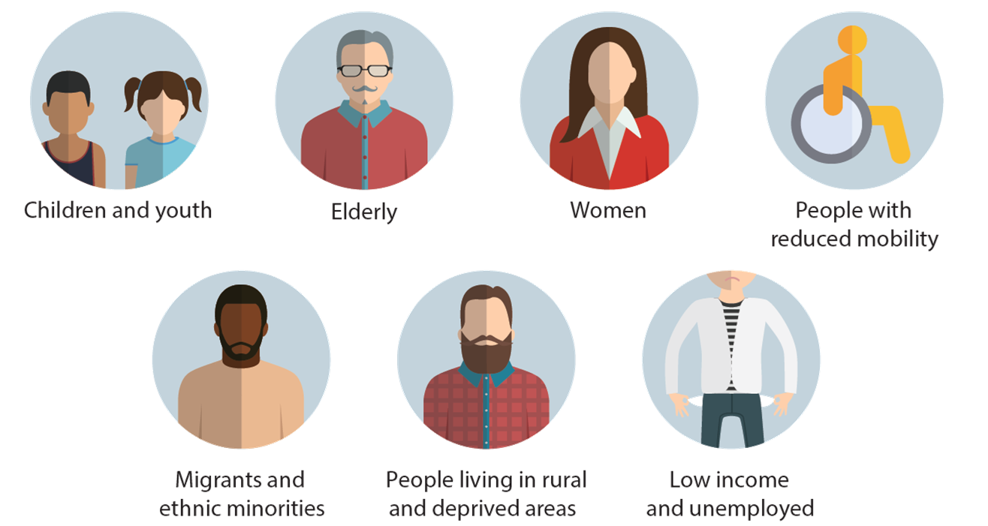
Not all needs are the same…
Source: © HiReach project (https://hireach-project.eu/)

Slide 4
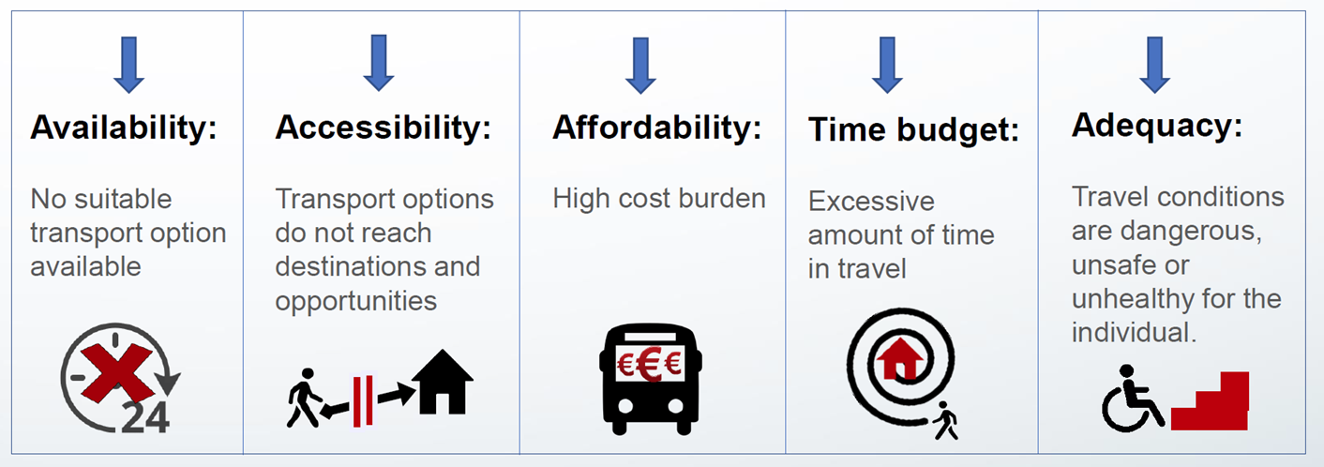
Transport poverty
Source: © HiReach project (https://hireach-project.eu/)

Slide 5
How to move forward?
Develop inclusive & accessible mobility services
Put the end-users first
Involve them in every phase
Reach out to vulnerable groups
Apply Universal Design principles

Slide 6
How to move forward?
Apply a multi-disciplinary approach
Engage stakeholders & avoid silo-thinking
Adopt public-private cooperation
Educate and empower!
Share knowledge & give feedback
Customize communication

Slide 7
Thank you!
Katie Bulanowski
European Passengers’ Federation
kathryn.bulanowski@epf.eu
epf.eu
Join us in Warsaw!
June 21 & 22
epfconference.eu

